Slide 1
Python workshop

Slide 2
Python workshop
Ping Pong Game
Team Name : The king slayers
Team Number : Team 18
Team mentor
Er Sathish R M.E.,(PhD).,
Assistant Professor,
Dept of IT,KiTE
Team members:
* Dinesh.R (Er) [18IT10]
* Gayathri.V (Er)[18IT12]
* Enoch Philip .M.K (Er)[18IT11]

Slide 3
Title: Ping Pong Game
Problem Statement:
A simple Ping Pong Game
Ping Pong game developed
Using Pygame

Slide 4
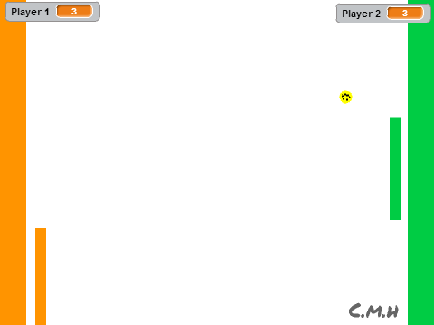
We developed simple ping pong game using pygame

Slide 5
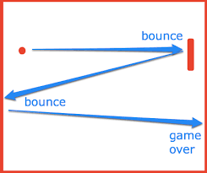
Feature :
Bouncing
two player
Infinity game play

Slide 6
Abstract:
Ping-pong, is a game
in which two players hit a ball back and forth across a screen using paddle.The players must allow a ball played toward them to bounce one time on their side of the screen, And must return it so that it bounces on the opposite side at least once. A point is scored when a player fails to return the ball within the rules. Play is fast and demands quick reactions.the score which is equal to the times that ball hits the edge of the window.When the ball hits the wall,score will add on the screen.The game is continue untill you left the game.

Slide 7
Introduction and The basic window setup

Slide 8
Step 1:
Introduction and the basic creation of the game.

Slide 9

Module:
The basic creation of the game is to create a background.We import the window screen and the title of the game.Then we give the background colour and we setup the width and height of the background image.

Slide 10
Step 2
Creating Game Objects to the Screen
(Paddles & ball)

Slide 11
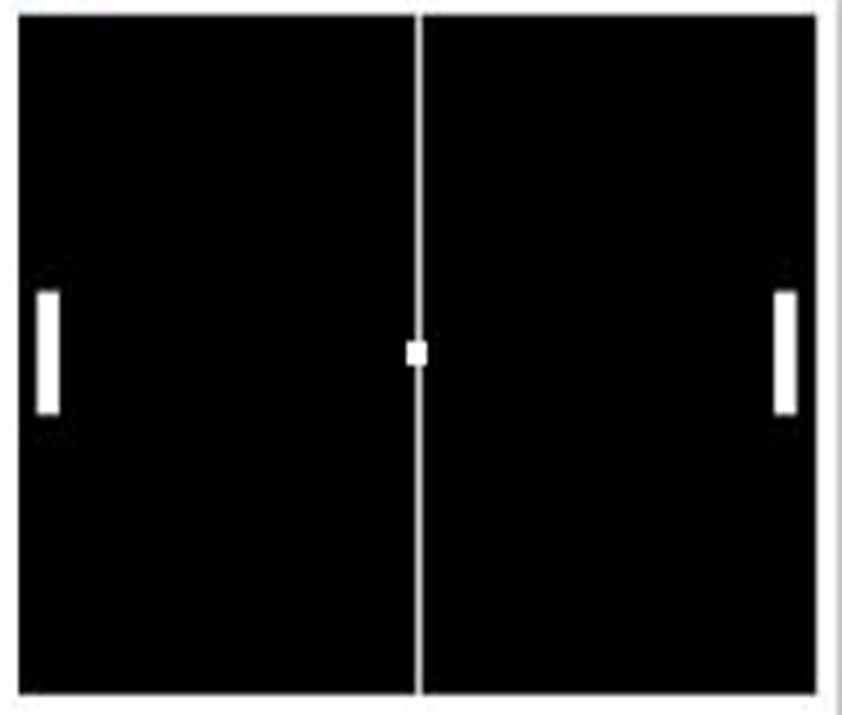
Module:
We next add the game objects to screen.The objects are the paddles and the ball.We create the paddle A by giving the shape,color and size.Then we create the paddle B by giving the same attributes.Next we create the ball by giving the shape, color and size.

Slide 12
Step 3
Moving the Paddles

Slide 13
# Function
After creating the paddles and the ball, now we give the function to move the paddles.Now we give the function for the padlle A to go upwards as y=paddle a.ycor(), and paddle A to move down as before.Then we give the function to paddle B as the functions we have given before.
# Keyboard binding
Now we give the keyboard bindings to the paddles to move up and down.The Paddle A will move up and down by pressing the ‘W’ and ‘S’ keys and the paddle B will move up and down by pressing the ‘UP’ and ‘DOWN’ arrow keys.

Slide 14
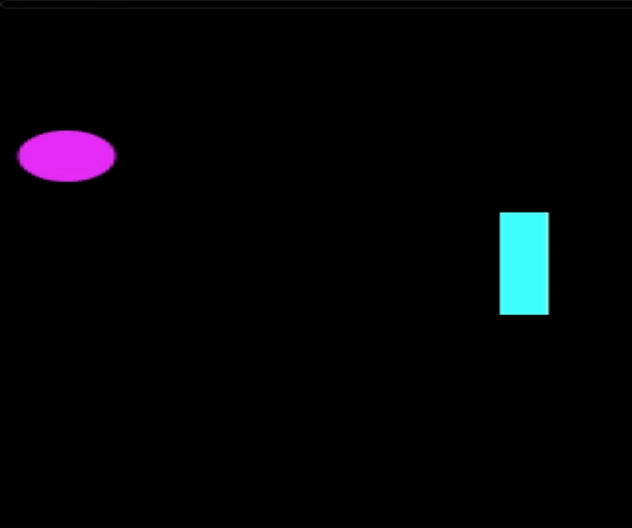

Slide 15
Step 5
Moving the Ball

Slide 16
Module:
Next we compute to move the ball around the screen.To move the ball around x-axis and y-axis use ball.setx(ball.xcor()+ball.dx) and same for y-axis. The player must allow the ball played towards them to bounce one time on their side of the screen. if the player must play fast and demand quik reaction if they lose .

Slide 17
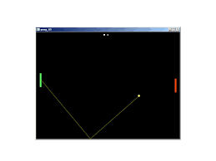

Slide 18
Step 6
Colliding with paddles

Slide 19
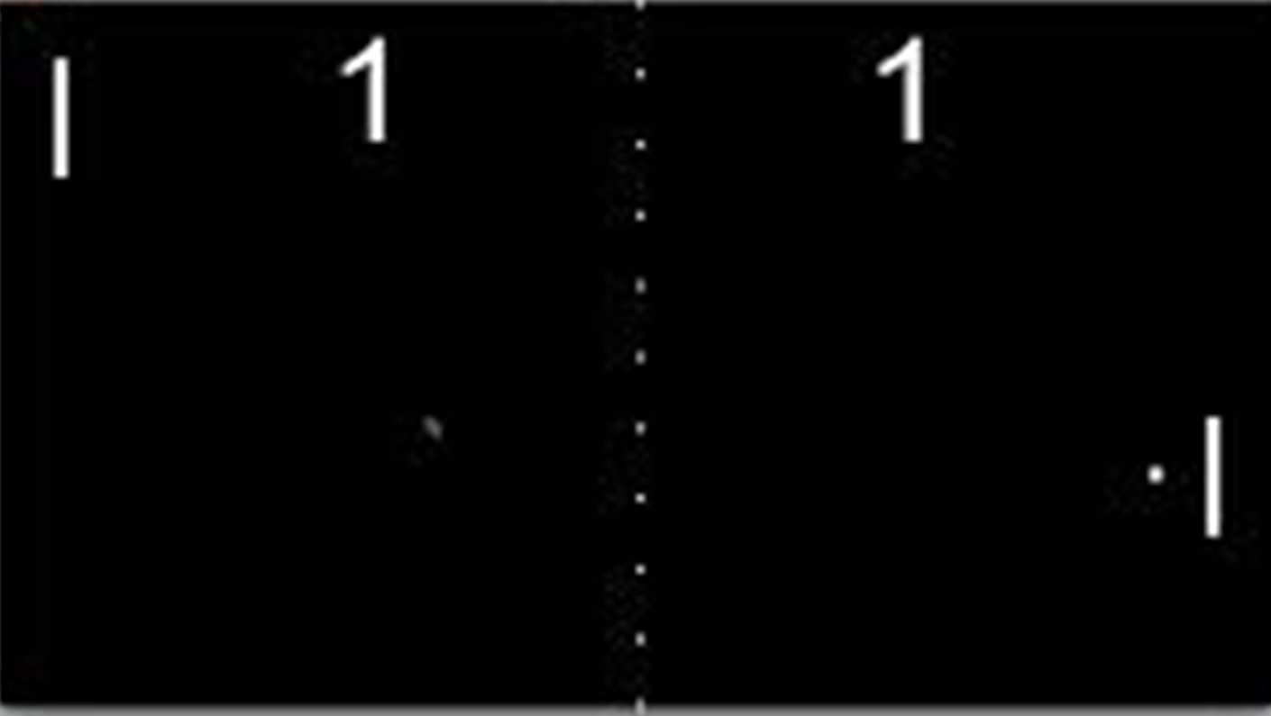
Module:
We compute the paddles and ball collide to each other to make the ball bounce on the paddle.

Slide 20
Step 7
Scoring

Slide 21
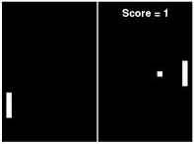
Module:
Next to display the score points we compute the text to where it placed and it will display the two players scores and the text size.

Slide 22
THE END

